Slide 1
Section C Enzyme
杨国栋
Biochemistry and Molecular Biology, College of Life Sciences
gdyang@sdau.edu.cn
13854808762

Slide 2
Section C - Enzyme
C1C2 Introduction to Enzymes
C3 Enzyme Kinetics
C4 Enzyme inhibition
C5 Regulation of Enzyme activity

Slide 3
C1C2 Introduction to Enzymes
Enzymes were among the first biological macromolecules to be studied chemically.
1.1 Much of the early history of biochemistry is the history of enzyme research.

Slide 4
1.1.1 Biological catalysts were first recognized in studying animal food digestion and sugar fermentation with yeast (brewing and wine making).
1.1.2 Ferments (i.e., enzymes, meaning in “in yeast”) were thought (wrongly) to be inseparable from living yeast cells for quite some time (Louis Pasteur)
1.1.3 Yeast extracts were found to be able to ferment sugar to alcohol (Eduard Buchner, 1897, who won the Nobel Prize in Chemistry in 1907 for this discovery).

Slide 5
1.1.4 Enzymes were found to be proteins (1920s to 1930s, James Sumner on urease, “all enzymes are proteins”, John Northrop on pepsin, chymotrypsin and trypsin, both shared the 1946 Nobel Prize in Chemistry).
1.1.5 Almost every chemical reaction in a cell is catalyzed by an enzyme (thousands have been purified and studied, many more are still to be discovered!)
1.1.6 Proteins do not have the absolute monopoly on catalysis in cells. Catalytic RNA were found in the 1980s (Thomas Cech, Nobel Prize in Chemistry in 1989).

Slide 6
2. The most striking characteristics of enzymes are their immense catalytic power and high specificity.
2.1 Enzymes accelerate reactions by factors of at least a million.
2.1.1 Most reactions in biological systems do not occur at perceptible rates in the absence of enzymes.
2.1.2 The rate enhancements (rate with enzyme catalysis divided by rate without enzyme catalysis) brought about by enzymes are often in the range of 10⁸ to 10²⁰)
2.1.3 For carbonic anhydrase, an enzyme catalyzing the hydration of CO₂ (H₂O + CO₂ → HCO₃⁻ + H⁺), the rate enhancement is 10⁷ (each enzyme molecule can hydrate 10⁵ molecules of CO₂ per second!)

Slide 7
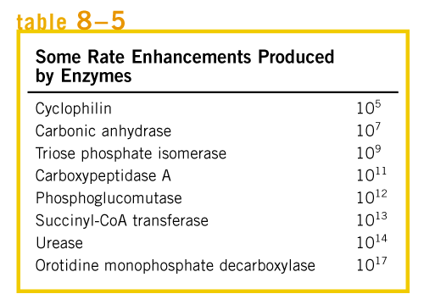

Slide 8
2.2 Enzymes are highly specific both in the reaction catalyzed and in their choice of substrates (i.e., reactants).
2.2.1 Enzymes exhibit various degrees of specificity in accord with their physiological functions :
Low specificity: some peptidases, esterases, and phosphatases.
Intermediate specificity: hexokinase, alcohol dehydrogenases, trypsin.
Absolute or near absolute specificity: Many enzymes belong to this group, and in extreme cases, stereochemical specificity is exhibited (i.e., enantiomers are distinguished as substrates or products).

Slide 9
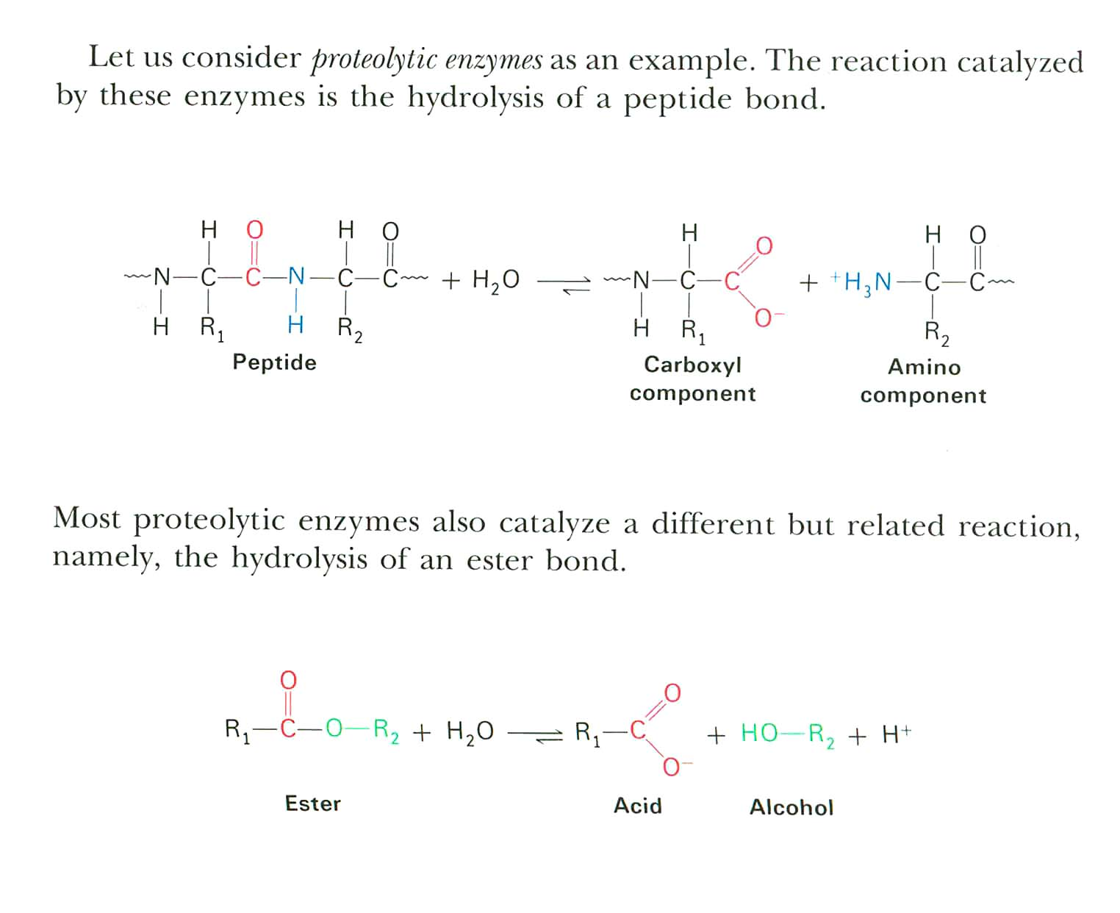

Slide 10
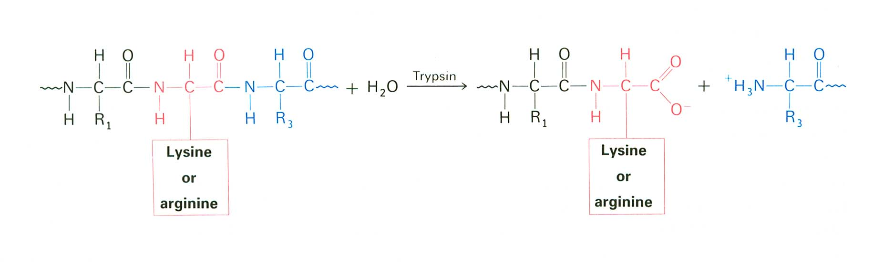
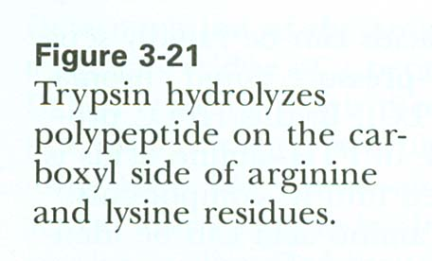

Slide 11
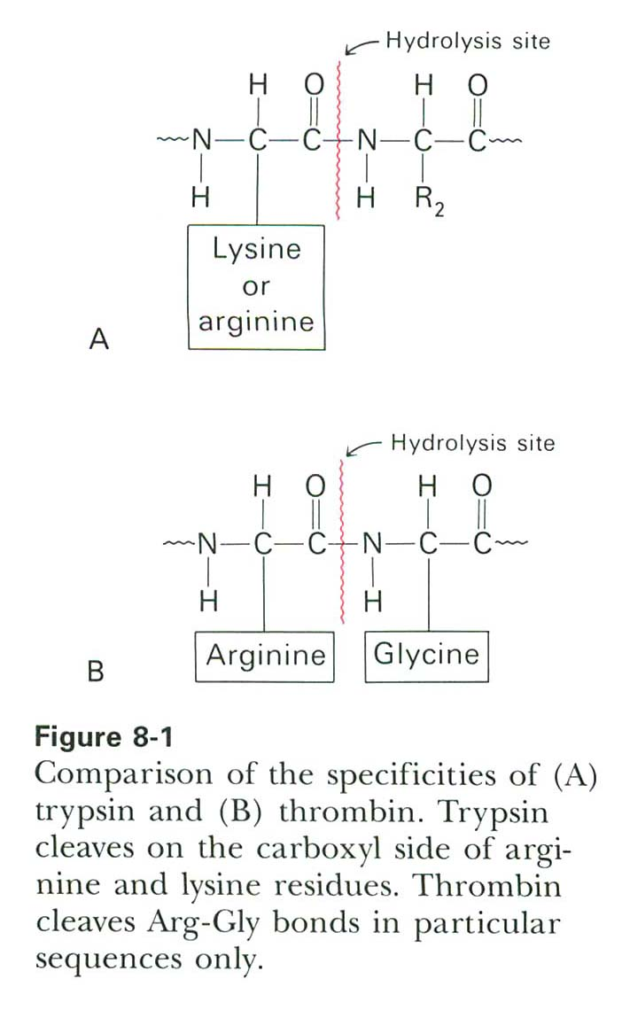
thrombin
n. 凝血酶

Slide 12
2.3 Most enzymes are proteins.
2.3.1 Some enzymes require no other chemical groups other than their amino acid residues for activity.
2.3.2 Some enzymes require the presence of cofactors, small nonprotein units, to function. Cofactors may be inorganic ions or complex organic molecules called coenzymes. A cofactor that is covalently attached to the enzyme is called a prosthetic group.
2.3.3 Prosthetic groups could be inorganic metal ions (e.g., Fe²⁺, Mg²⁺, Mn²⁺, Zn²⁺) or complex organic or metalloorganic molecules.

Slide 13
2.3.4 A complete catalytically active enzyme (including its prosthetic group) is called a holoenzyme.
2.3.5 The protein part of an enzyme (without its prosthetic group) is called the apoenzyme.
2.3.6 Many vitamins, organic nutrients required in small amounts in the diet, are precursors of coenzymes.

Slide 14
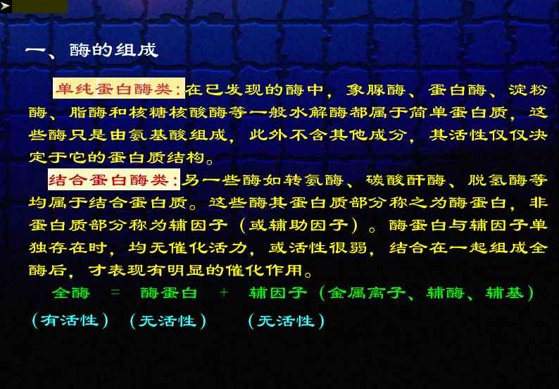
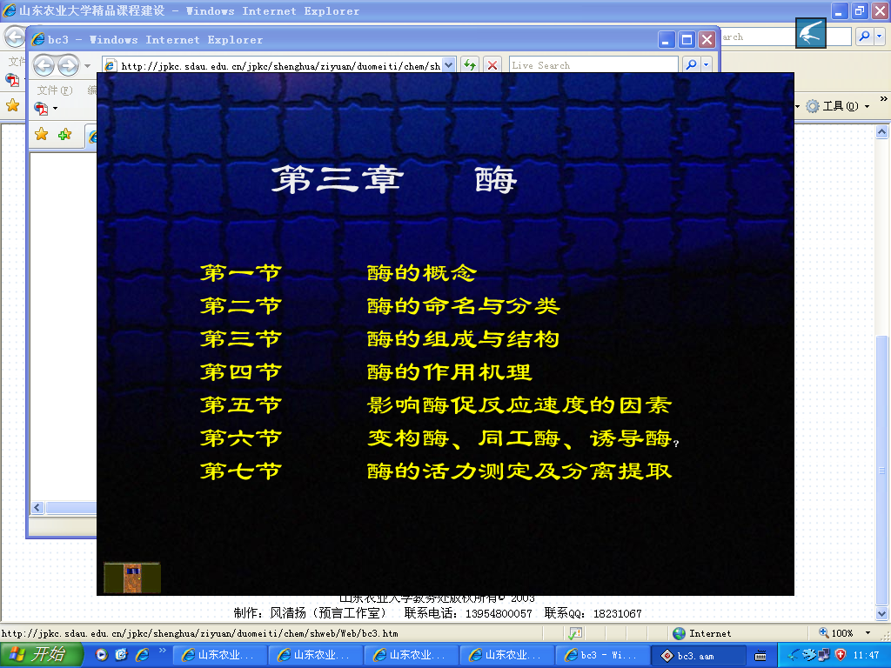

Slide 15
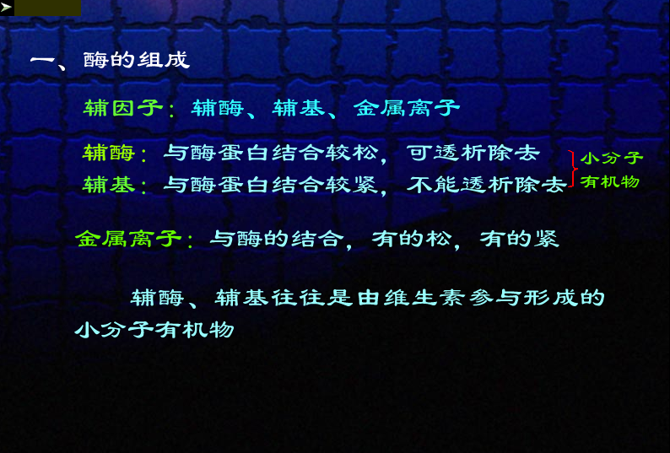

Slide 16
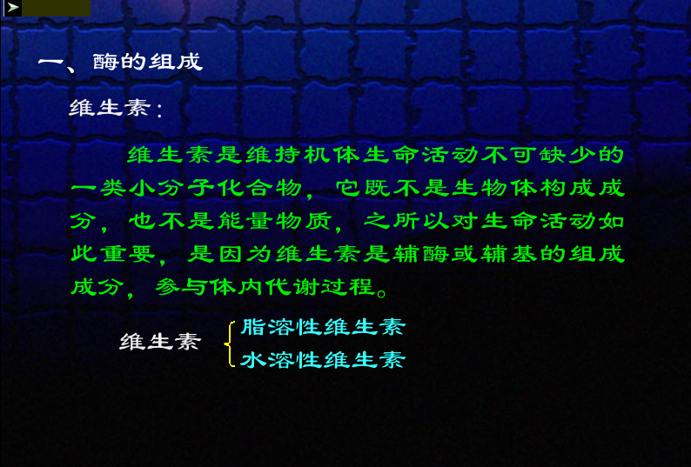

Slide 17
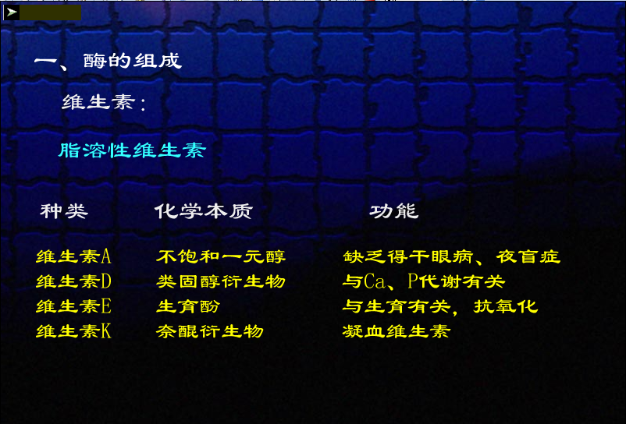

Slide 18
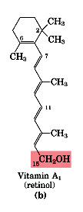
脂溶性维生素：
A、D、E、K
视黄醇

Slide 19
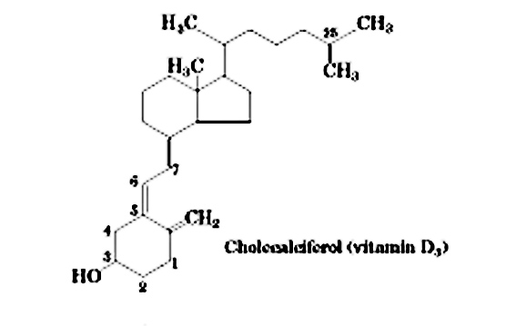
Vitamin D3
甾醇衍生物

Slide 20
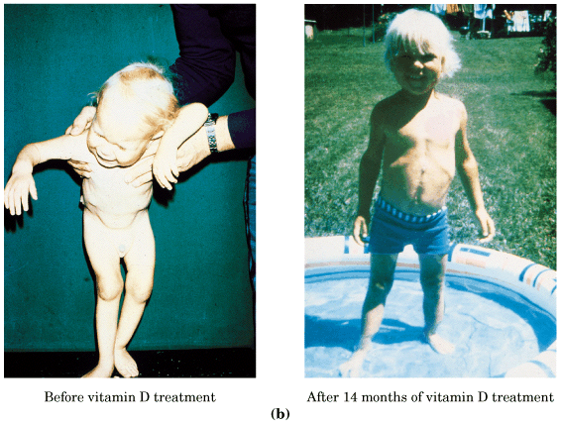

Slide 21


Vitamin E
生育酚
Vitamin K
凝血维生素

Slide 22
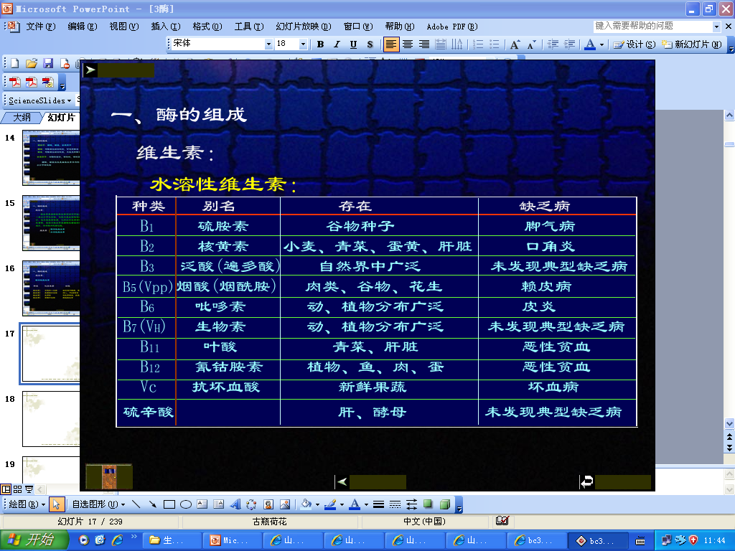

Slide 23
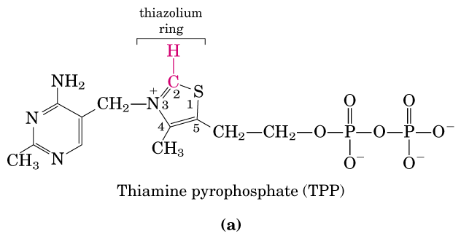
水溶性维生素：B族、硫辛酸和维生素C

Slide 24
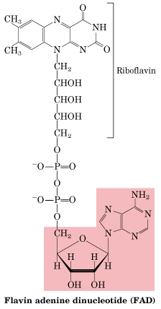

Slide 25
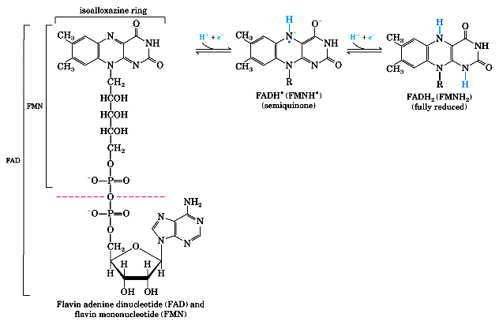

Slide 26
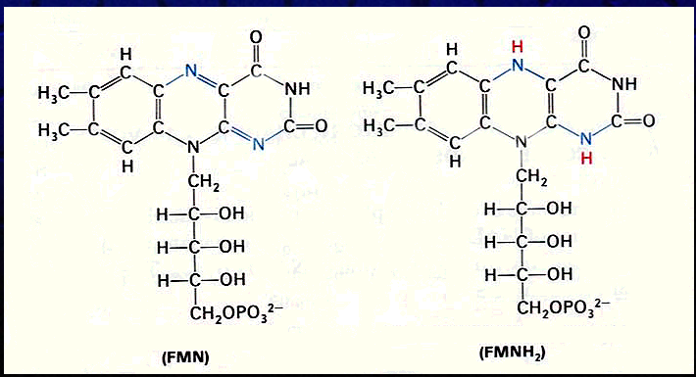

Slide 27
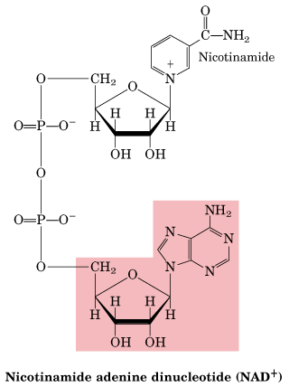
B3

Slide 28
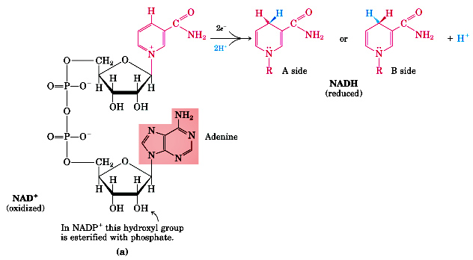
NAD / NADP
辅酶I / 辅酶II

Slide 29
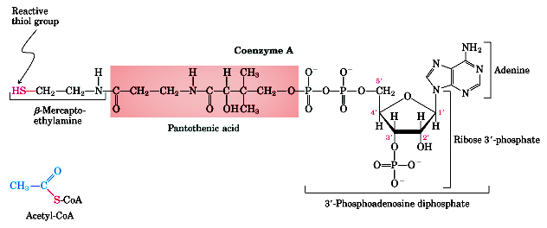
B5
Coenzyme A 辅酶A

Slide 30
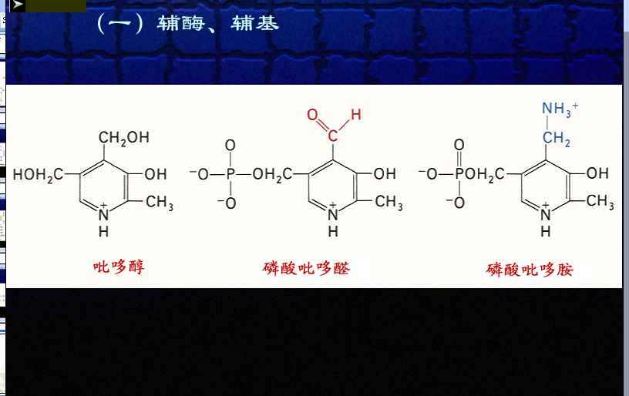
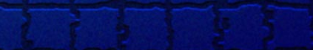
PLP

Slide 31
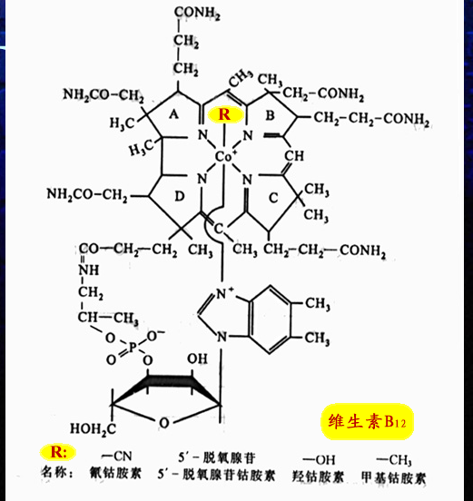

Slide 32
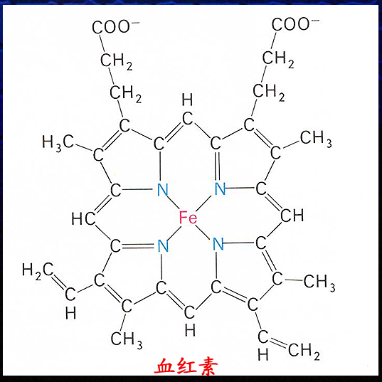
Fe²⁺
ferrous

Slide 33
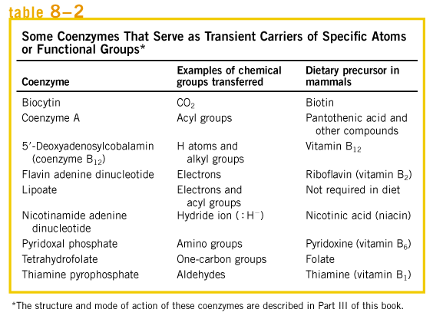

Slide 34
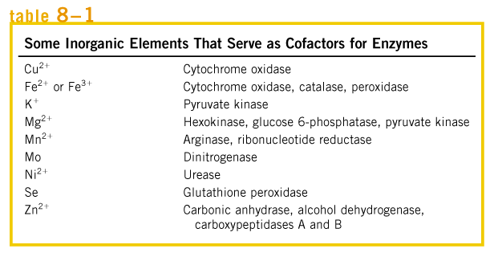

Slide 35
3. Enzymes are classified by the reactions they catalyze
3.1 Trivial names are usually given to enzymes.
3.1.1 Many enzymes have been named by adding the suffix “-ase” to the name of their substrate or to a word or phrase describing their activity (type of reaction).
3.2 Enzymes are categorized into six major classes by international agreement.
3.2.1 The six major classes include
Oxidoreductases: catalyzing oxidation-reduction reactions.
Transferases: catalyzing the transfer of a molecular group from one molecule to another.

Slide 36
Hydrolases: catalyzing the cleavage by the introduction of water.
Lyases(such as synthase, hydratase): catalyzing reactions involving removal of a group to form a double bond or addition of groups to double bonds.
Isomerases: catalyzing reactions involving intramolecular rearrangements.
Ligases (such as synthetases): catalyzing reactions joining together two molecules.

Slide 37
3.2.1 酶的分类
1. 氧化还原酶类 AH2 + B A+BH2
2. 转移酶类 AR + B A+BR
3. 水解酶类 AB + H2O AOH+BH
4. 裂合酶类 AX— BY A=B + X-Y
5. 异构酶类 A B
6. 合成酶类 A + B + ATP AB + ADP +Pi

Slide 38
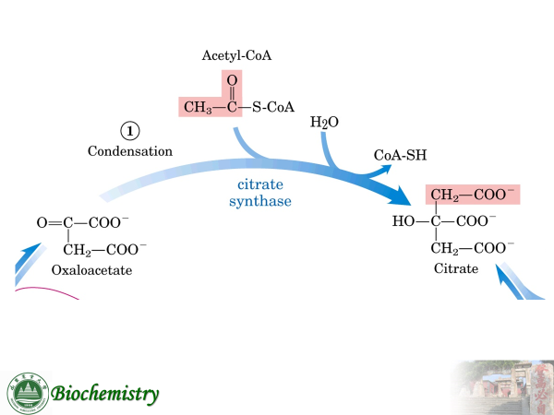
举例 synthase（lyase）

Slide 39
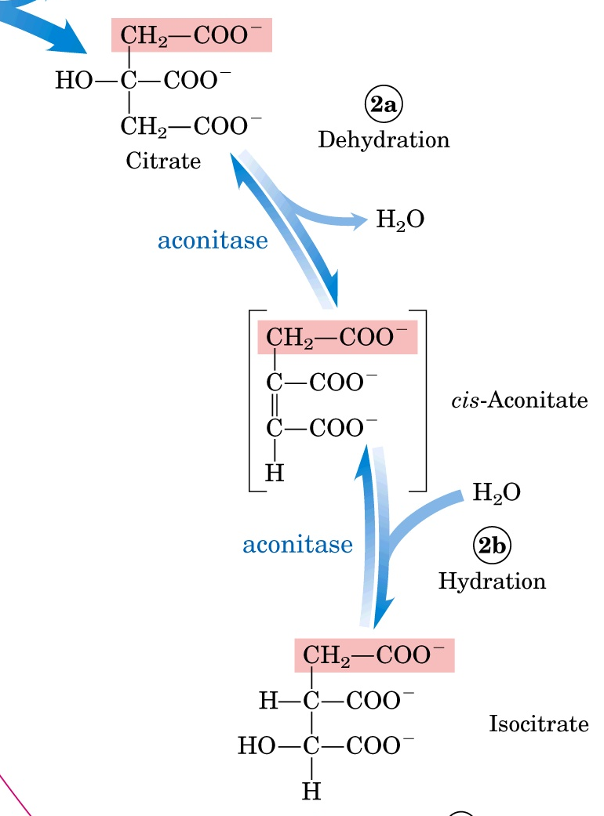
Hydratase （lyase）

Slide 40
Amino acid + ATP + tRNA aminoacyl-tRNA + AMP +PPi
aminoacyl-tRNA synthetase

Slide 41
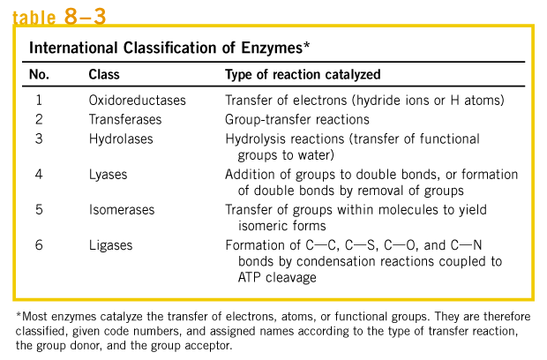

Slide 42
3.3 Each enzyme is given a systematic name which identifies the reaction catalyzed (e.g., hexokinase is named as ATP:glucose phosphotransferase).
3.4 Each enzyme is assigned a four-digit number with the first digit denoting the class it belongs, the other three further clarifications on the reaction catalyzed.
Each enzyme is then uniquely identified by a four-digit classification number. Thus trypsin has the Enzyme Commission (EC)number 3.4.21.4. (e.g. Trypsin, EC 3.4.21.4)

Slide 43
glucokinase
ATP: D-glucose phosphotransferase
A phosphate group is transferred from ATP to the C-6-OH group of glucose, so the enzyme is a transferase.
E.C.2.7.1.2,

Slide 44
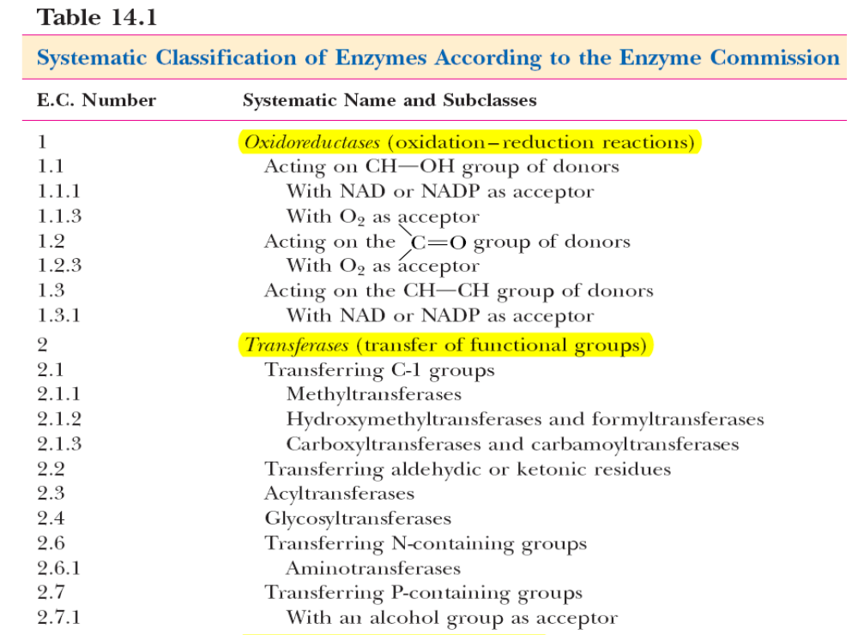

Slide 45
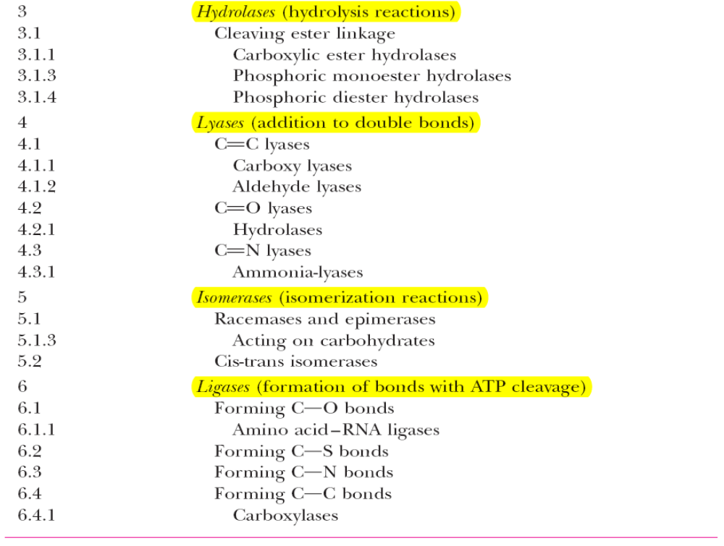

Slide 46
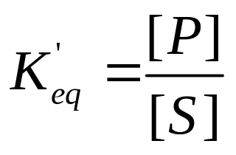
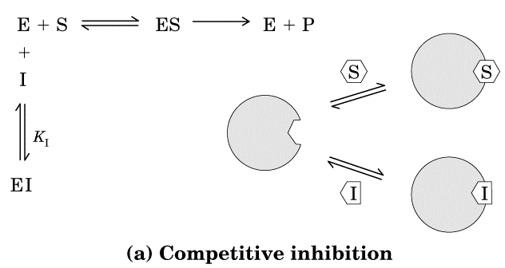
4. Enzymes, like all other catalysts, does not affect reaction equilibria, only accelerate reactions.
4.1 Equilibrium constant (K_{eq}’) of a reaction is related to the free energy difference between the ground states of the substrates and products (ΔG^{o’})
P S
Δ G^{o’} = -RTlnK_{eq}’
Enzyme catalysis does not affect Δ G^{o’}, thus not K_{eq}’.

Slide 47
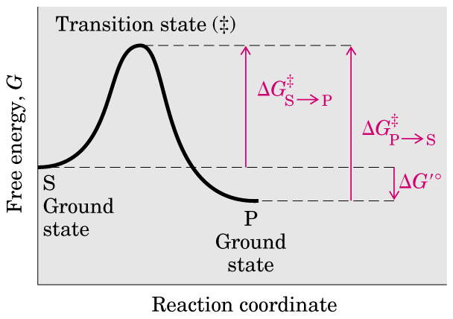
4.2 The rate constant of a reaction (k) is related to the free energy difference between the transition state and the ground state of the substrate (ΔG‡)
activation energy

Slide 48
For a biochemical reaction to proceed, the energy barrier needed to transform the substrate molecules into the transition state has to be overcome. The difference in free energy between the substrate and the transition state is termed the Gibbs free energy of activation (ΔG‡ )
ΔG^{‡-------} activation energy

Slide 49
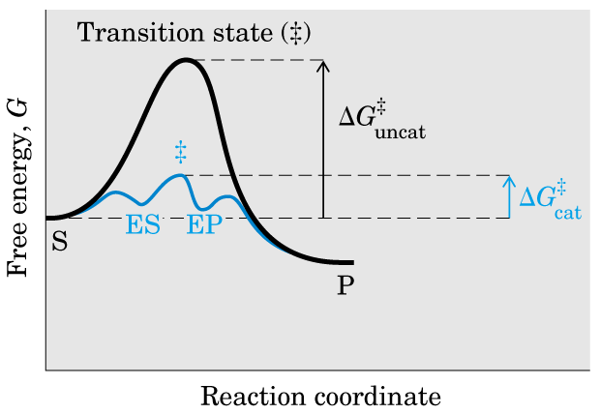

Slide 50
4.2.1 Transition state is a fleeting molecular moment (not a chemical species with any significant stability) that has the highest free energy during a reaction.
4.2.2 An enzyme increases the rate constant of a reaction (k) by lowering its ΔG‡.
4.2.3 The combination of a substrate and an enzyme creates a new reaction pathway whose transition state energy is lower than that of the reaction in the absence of enzyme.

Slide 51
5. Formation of an enzyme-substrate complex is the first step in enzyme catalysis.
5.1 Substrates are bound to a specific region of an enzyme called the active site.
5.1.1 Much of the catalytic power of enzymes comes from their bringing substrates together in favorable orientations in enzyme-substrate (ES) complexes.
5.1.2 Most enzymes are highly selective in their binding of substrates.

Slide 52
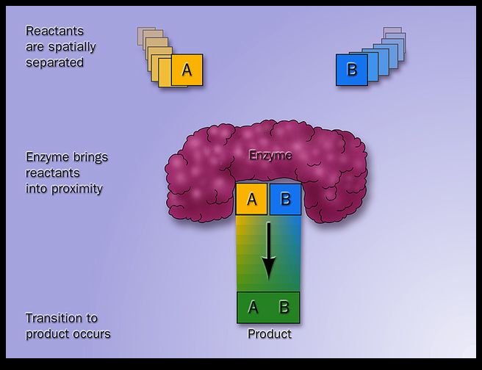
active site

Slide 53
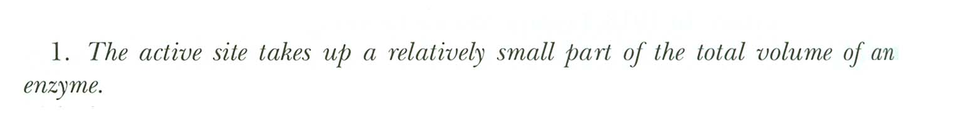
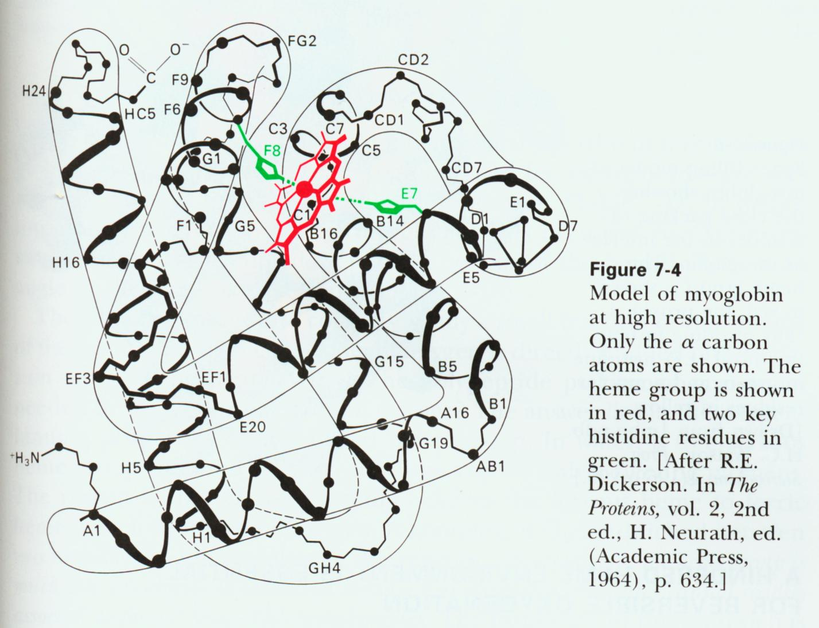
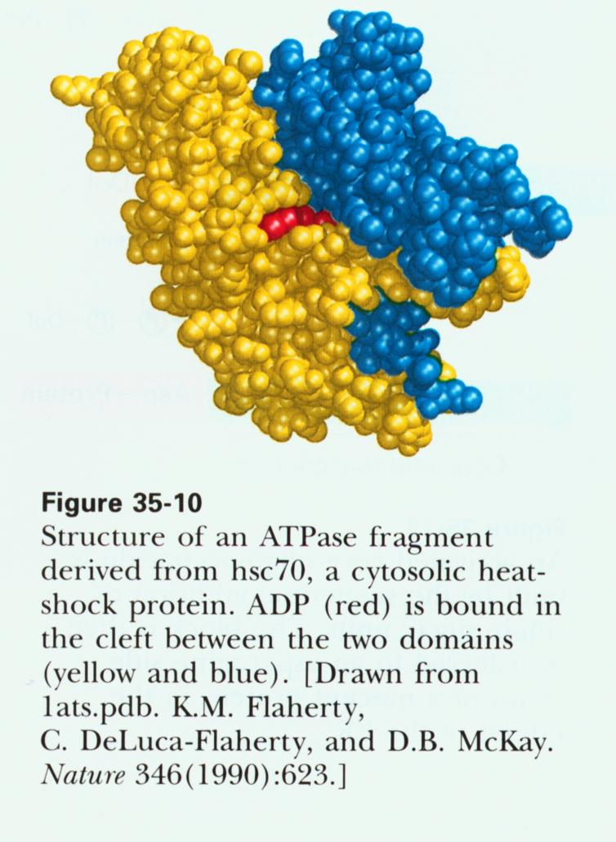
5.1.3 Common Features of the Active Sites

Slide 54
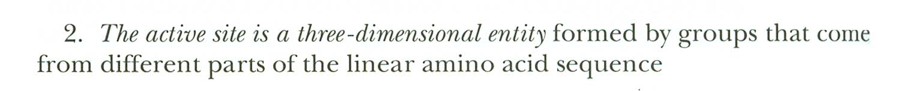
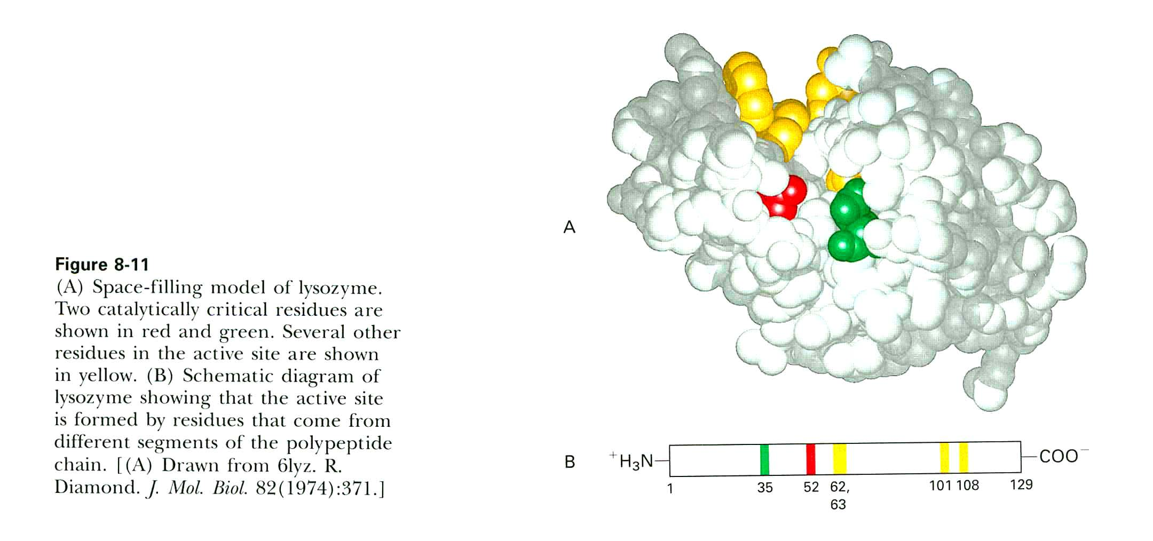

Slide 55
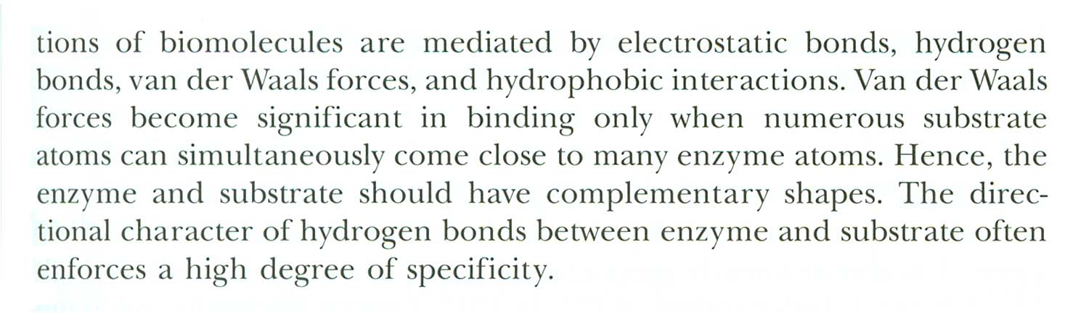
5.1.4 What are the types of the multiple weak interactions?
1
2
3
4
Note: “electrostatic bonds” should be called as “electrostatic interactions”

Slide 56
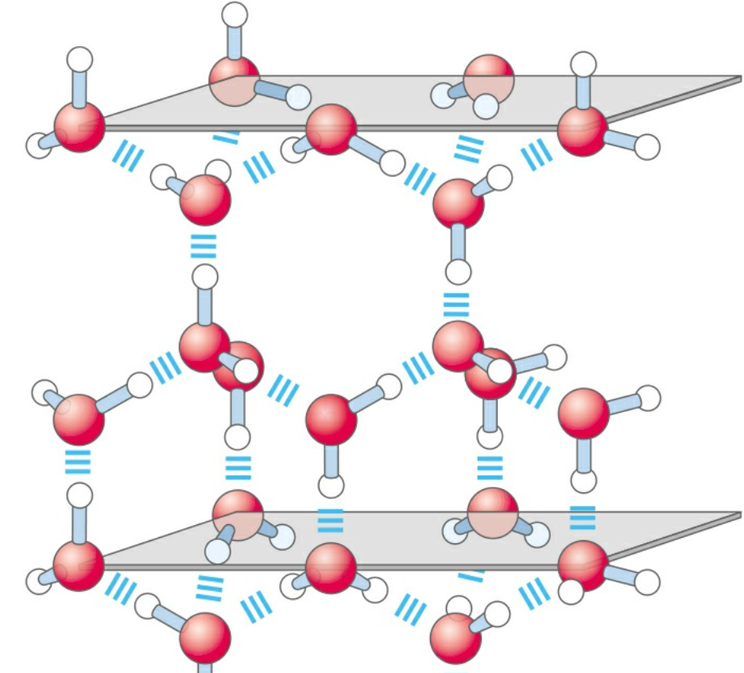
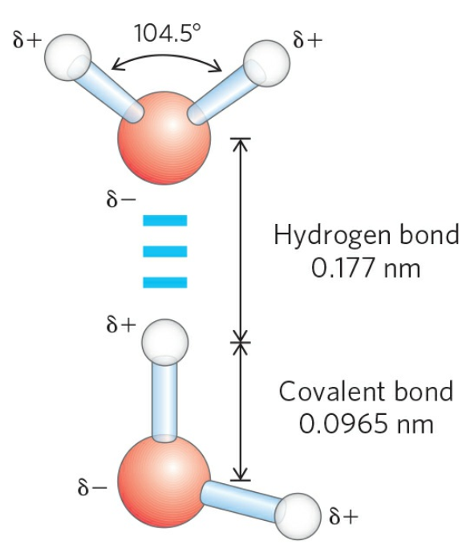
Hydrogen bonding in ice

Slide 57
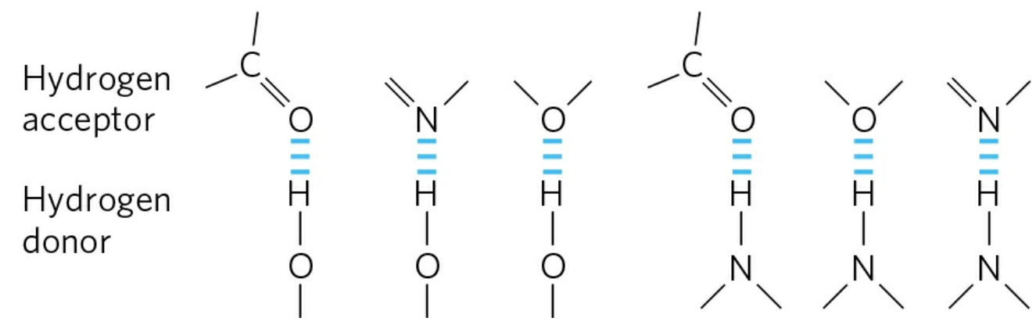
Common hydrogen bonds in biological systems

Slide 58
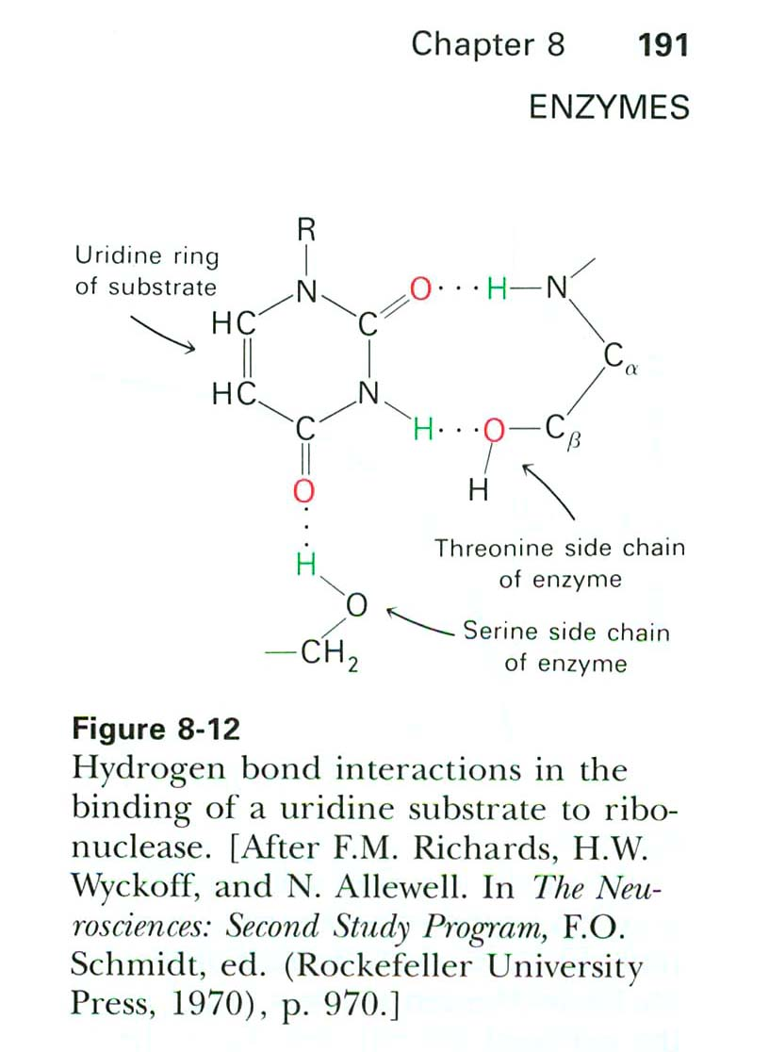

Slide 59
5.1.5 The active sites of some unbound enzymes are complementary in shape to those of their substrates (the lock-and-key metaphor, Emil Fisher).
5.1.6 In many enzymes, the active sites have shapes complementary to those of their substrates only after the substrates are bound (the induced-fit model, Daniel Koshland).

Slide 60
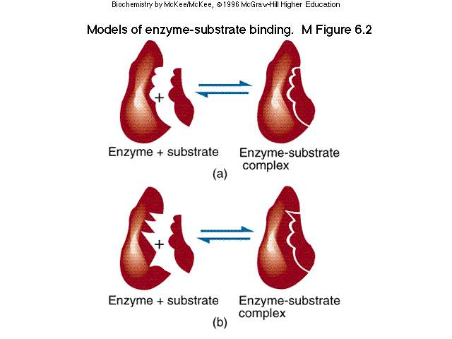

Slide 61
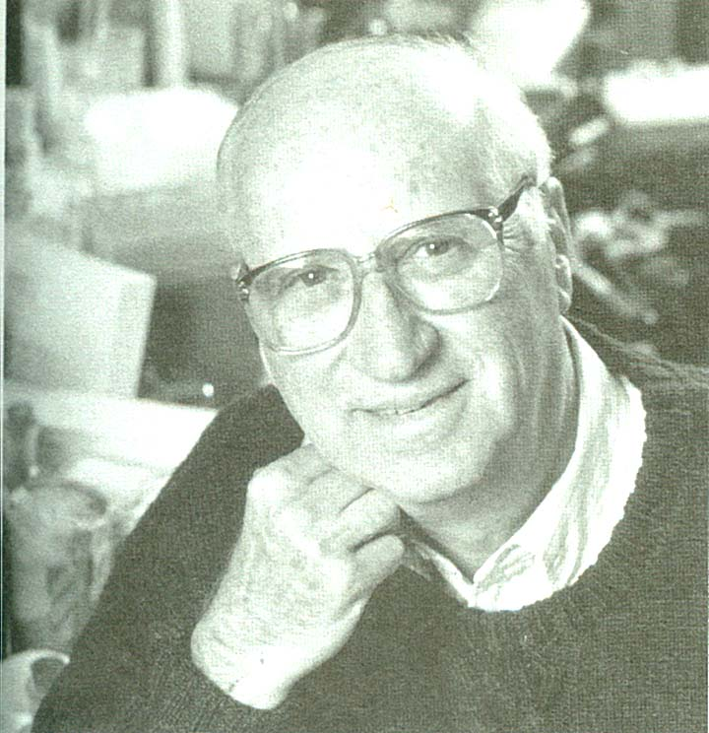


Slide 62
5.2 The existence of ES complexes has been shown in a variety of ways.
5.2.1 The saturation effect: at a constant concentration of an enzyme, the reaction rate increases with increasing substrate concentrations until a Vmax is reached.
5.2.2 ES complexes have been directly observed by electron microscopy and X-ray crystallography.

Slide 63
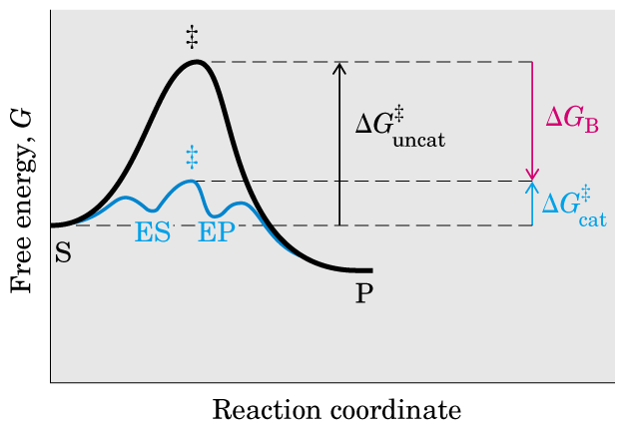


Slide 64
6. Various factors leading to rate enhancements are proximity and orientation effects, strain or distortion acid-base catalysis, covalent catalysis, and changes in environment.
6.1 Proximity and orientation effect
An enzyme could increase the rate of a reaction involving more than one substrate by binding the substrates at adjacent sites and therefore bringing them into close proximity with each other.
The orientation of the reacting molecules with respect to each other can greatly influence the rate of reaction.

Slide 66


Slide 67
6.2 Strain or distortion
The bonds in a substrate may be distorted on binding to the appropriate enzyme. This would speed up the reaction if the distortion (or strain) lowered the free energy of activation by making the geometry and electronic structure of the substrate.

Slide 68


Slide 69
6.3 Acid-base catalysis
Since enzymes contain a number of amino acid side-chains that are capable of acting as proton donors or acceptors, it is reasonable to suppose that acid-base catalysis would be important in enzyme-catalysed reaction.

Slide 70


Slide 71


Slide 72
6.4 Covalent catalysis (intermediate formation)
In this type catalysis, a transient covalent bond is formed between the enzyme and the substrate.
Reactions can be speed up by the formation of intermediates, provided that such intermediates are both rapidly formed and rapidly broken down.

Slide 73


Slide 74


Slide 75
6.5 Changes in environment
X-ray crystallographic studies show that enzymes are capable of providing unusual environments for reactions. For instance, in the case of lysozyme, the cleft in the molecule that forms the substrate-binding site is lined by a number of non-polar amino acid side-chains; these clearly provide an environment markedly different from that of the solvent water.

Slide 76


Slide 77


Slide 78
An enzyme may use a combination of several catalytic strategies to bring about a rate enhancement.
Chymotrypsin uses both covalent catalysis and general acid-base catalysis.

Slide 79

作用机理实例——胰凝乳蛋白酶

Slide 80




Slide 81


Slide 82

1. 通过电荷转移，使Ser有更强的亲核力

Slide 83

2. 形成酰化酶，放出产物P1

Slide 84

3. 脱酰（水解），形成产物P2

Slide 85


Slide 86


Slide 87
C3 Enzyme Kinetics
Michaelis-Menten equation reflects the kinetic behavior of many enzymes
1.1 Saturation effect was observed in enzyme catalysis when plotting the initial velocity (V_{o}) against the substrate concentration ([S]).
1.2 The ES complex was proposed to be a necessary step in enzyme catalysis based on this kinetic pattern.

Slide 88
酶促反应速度的测量
（酶促反应初始速率initial rate or initial velocity）
[P]
[t]
[t1]

Slide 89

Saturation effect
V_{max}

Slide 90


Slide 91


Slide 92


Slide 93


Slide 94


Slide 95


Slide 96
1.3 The Michaelis-Menten equation was established to account for the observed relationship between Vo and [S].
1.3.1 A single-substrate, single-product reaction is considered for simplicity.
S P

Slide 97


1.3.2 At early times in the reaction, the concentration of the product ([P]) is and the overall reaction can be written as (no reverse reaction)
1.3.3 It is hypothesized that the rate-limiting step in enzymatic reactions is the breakdown of the ES complex to form the product and the free enzyme:
V=K₂[ES]

Slide 98
1.3.4
the rate of ES formation = the rate of ES breakdown
the rate of ES formation = k₁([Et]-[ES])[S],
the rate of ES breakdown = k₋₁[ES]+k₂[ES].
1.3.5 The free enzyme concentration
[E]=[E_{t}]-[ES]
([E_{t}] is the total enzyme concentration).

Slide 99
1.3.6 The amount of substrate bound by the enzyme at any given time is negligible compared with the total [S], because [S] is usually far greater than [E_{t}] ([S]>>[Et], still true for low [S]); therefore, the free substrate concentration is [S].
1.3.7 K_{m} =(k₋₁+k₂)/k₁, is the Michaelis-Menten constant.

Slide 100




1.3.8 米氏方程推导过程
the rate of ES formation = k₁([Et]-[ES])[S],
the rate of ES breakdown = k₋₁[ES]+k₂[ES].
k₁([Et]-[ES])[S]= k₋₁[ES]+k₂[ES]
([Et]-[ES])[S]=( k₋₁ +k₂)/ k₁ [ES]
Michaelis constant
米氏常数

Slide 101
This is the Michaelis-Menten equation.
The equation fits the observed curve very well.
When [S] is very low (<<Km), Vo=Vmax[S]/Km
when [S] is very high (>>Km), Vo=Vmax

Slide 102


If [S]<<Km,
If [S]>>Km,
maximum velocity, Vmax
If V₀=1/2 V_{max}
Km=[S]
Km（Michaelis constant，米氏常数）
是反应速度为最大值的一半时的底物浓度。
米氏常数的单位为mol/L。
Km equals to the substrate concentration
at which the reaction rate is half its maximal value

Slide 103
米氏常数Km 的意义
重要特征物理常数，与酶浓度无关。不同的酶具有不同Km值，Km=10⁻³ - 10⁻⁵ mol/L.
Km值是在固定的底物，一定的温度和pH，一定的缓冲体系中测得的，不同条件下具有不同的Km值。
Km值可表示酶与底物之间的亲和力：Km值大表示亲和程度小，酶的催化活性低; Km值小表示亲和程度大,酶的催化活性高
同一种酶有几种底物就有几个Km值，其中Km值最小的底物一般称为该酶的最适底物或天然底物

Slide 104
1.4 Km equals to the substrate concentration at which the reaction rate is half its maximal value (Vo=Vmax/2).
Km and Vmax can be determined by varying the substrate concentrations--The Michaelis-Menten equation can be transformed by taking double reciprocal of both sides into the following form:
1 K_{m} 1 1
------ = ------ ． ------ + --------
V_{o} V_{max} [S] V_{max}

Slide 105

1.4.1 A plot of 1/Vo versus 1/[S] yields a straight line, The double reciprocal plot is called the Lineweaver-Burk plot.

Slide 106


Slide 107


Slide 108


Slide 109

K_{m}是酶的特征常数，1/K_{m}近似表示酶与底物的亲和力

Slide 110
2. When [S] is saturating, a doubling of the enzyme concentration leads to a doubling of Vo.
Vo
[E]

Slide 111

3. Effects of temperature on the rate

Slide 112
4. Enzyme activity is affected by pH
4.1 Each enzyme has an optimal pH or pH range (where the enzyme has maximal activity).
4.1.1 Requirements for the catalytic groups in the active site in appropriate ionization state is a common reason for this phenomenon.
4.1.2 Change of ionization state of surface groups (which may affect the protein structure) sometimes is responsible for this phenomenon.
4.1.3 In rare cases, it is the change of ionization state of substrate that is responsible for this phenomenon.

Slide 113


Slide 114
4.2 The pH range over which activity changes can provide a clue to what amino acid residues are involved.
4.2.1 This has to be treated with great caution, because in a closely packed environment of a protein, the pK values of amino acid side chains can change significantly (e.g., a nearby positive charge will increase the pK value of a Lys residue, and a negative one will decrease the pK!).

Slide 115
5. Enzyme assays (quantification of enzyme (activity) )
An enzyme assay measures the conversion of substrate to product, under conditions of cofactors, pH and temperature at which the enzyme is optimally active.
High substrate concentrations are used so that the initial reaction rate is proportional to the enzyme concentration.
Enzyme activity is commonly expressed by the initial rate (Vo). The units of Vo are μmol min⁻¹
1 U=1 μmol min⁻¹
1 kat = 1 mol s⁻¹ 1 kat = 6 x 10⁷ U

Slide 116
Specific activity (μmol min⁻¹ mg⁻¹) 比活力: The number of micromoles (mol) of a substrate transformed by an enzyme preparation per minute per milligram of protein at 25℃; a measure of enzyme purity.
Specificity: The ability of an enzyme or
receptor to discriminate among competing
substrates or ligands.

Slide 117

酶偶联法
Linked enzyme assays
E1
E2
S P1 P2
条件：S P1反应很慢，P1 P2反应很快
偶联工具酶E2纯度高，加入酶量过量
P2有光吸收或荧光变化

Slide 118
Isoenzymes
Isoenzymes are different forms of an enzyme which catalyze the same reaction, but which exhibit different physical or kinetic properties. The isoenzymes of Lactate DeHydrogenase (LDH) can be separated electrophoretically and can be used clinically to diagnose a myocardial infarction.

Slide 119
同工酶（isozyme）
概念：催化同一化学反应，但其酶蛋白本身的组成、分子结构有所不同的一组酶，一般由2个或以上的亚基构成。

Slide 120
同工酶技术的应用，与酶制剂应用不同，不是将酶单纯的作为催化剂，追求酶的高效而专一的催化功能，它更多是把同工酶作为一组分子标记物，利用酶灵敏而专一的检测之便，显示生物物种或个别体基因型的共性和个性。

Slide 121
命名
1.组织命名：酶名称前加组织名称
肝（L） 肌（M） 肾（K） 心（H） 脑（B)
LDH M型 H型
2.数字命名
1976年 IUB：在规定条件下，按向阳极移动速度快慢，用数字依次给同工酶的各条电泳区带编号。
4 3 2 1
-
+

Slide 122
A、B、C命名法
不同亚基用A、B、C表示
LDH亚基分为M型和H型，4个亚基组成
M型（肌型）——含碱性氨基酸
H型（心型）——含酸性氨基酸
LDH的5种组分：
LDH1 LDH2 LDH3 LDH4 LDH5
H4 H3M H2M2 HM3 M4

Slide 123
应用：
1.同工酶与遗传的关系
基因变异引起同工酶谱的变化
如：LDH的基因型： A基因 B基因
如果等位基因A和A中的一个基因发生了变异，变成A*，
这时由A、A*、B三种基因编码，分别产生三种亚基，
A A* B

Slide 124
15种分子形式
LDH5 LDH4 LDH3 LDH2 LDH1
A4 BA3 B2A2 B3A B4
A3A* BA2A* B2AA* B3A*
A2A*2 BAA*2 B2A*2
AA*3 BA*3
A*4

Slide 125
2.同工酶与个体发育的关系
乙醇脱氢酶 ADH：
发育早期：质片中 ADH₁、ADH₂
稍后：ADH₃、ADH₄
种子萌发的前10天 ADH₃ ，而 ADH₁、ADH₂ ADH₄仅在萌发的第一天存在，第四天后消失

Slide 126
3.同工酶与代谢调节的关系
D F
A B C
G H

Slide 127
4.同工酶 用于疾病诊断，灵敏且可靠：
心脏疾病 LDH₁↗ LDH₂↗ LDH₃ LDH₅↘
急性肝炎 LDH₅↗
肝硬化 LDH₅ LDH₁ LDH₃↗
原发生肝癌 LDH₃ LDH₄ LDH₅↗，
但LDH₅＞LDH4
转移性肝癌 LDH₃ LDH₄ LDH₅↗，
但LDH₄＞LDH5

Slide 128
C4 Enzyme inhibition
Enzyme inhibition
Reversible inhibition
Irreversible inhibition

Slide 129
1. The inhibition of enzymatic activity by specific small molecules and ions is important.
1.1 It serves as a major control mechanism in biological systems.
1.2 Many drugs and toxic agents act by inhibiting enzymes.
1.3 Inhibition can be a source of insight into the mechanism of enzyme action: residues critical for catalysis can often be identified by using specific (irreversible) inhibitors.

Slide 130
2. Reversible inhibition can usually be divided into different types.
2.1 Reversible inhibitors bind to enzyme noncovalently.
2.2 In competitive inhibition, the inhibitor competes with the substrate for the active site (binding of one prevents binding of the other, forming ES or EI complexes but no ESI complexes.).
2.3 Competitive inhibitors are often compounds that resemble the substrates.

Slide 131


Slide 132


Slide 133


Slide 134


Slide 135

the Km i observed in the presence of the inhibitor, is often called the “apparent” Km

Slide 136

α=1+[I]/K_{I} α >1

Slide 137


“apparent” Km
表观Km

Slide 138


Slide 139


Slide 140
Vmax is not affected by the presence of a competitive inhibitor (There is always some high substrate concentration that will replace the inhibitor from the enzyme’s active site).
Km is increased due to the presence of a competitive inhibitor. Higher substrate concentration is needed to achieve Vmax/2.

Slide 141

Inhibition of succinate dehydrogenase by malonate

Slide 142
In noncompetitive (or mixed competitive)
inhibition, the inhibitor binds to a site distinct from that (the active site) which binds the substrate.
Inhibitor binding does not affect substrate binding and vice versa (i.e., inhibitor can bind to ES complex, substrate can bind to EI complex).
The enzyme is inactivated when inhibitor is bound (whether or not substrate is also present). (e.g.)
The apparent Vmax is lowered (due to the concentration decrease of active enzymes)， apparent Km is increased (mixed) or not changed (noncompetitive).

Slide 143


Slide 144

Noncompetitive inhibition

Slide 145

K_{I}=K_{I}’

Slide 146

Mixed or noncompetitive inhibition, plots similar to
the sequential binding in ternary complexes
K_{I}=K_{I}’
α=α’
Km increased； Vmax decreased
Km not change； Vmax decreased

Slide 147

Noncompetitive inhibition

Slide 148


Slide 149

2.10 In uncompetitive inhibition, the inhibitor binds only to the ES complex (unable to bind to free enzyme).

Slide 150


Slide 151


Uncompetitive inhibition
Km Decreased； Vmax decreased

Slide 152



Slide 153

competitive
Mixed (noncompetitive)

Slide 154
uncompetitive

Slide 155


Slide 156


Slide 157
3 Irreversible inhibitors bind very tightly (covalently or noncovalently) to the enzymes.
3.1 Many irreversible inhibitors modify critical catalytic residues covalently, thus inactivating the enzymes.
3.2 DiIsopropylPhosphoFluoridate (DIPF, one component of the toxic nerve gases) reacts with a critical Ser residue on acetylcholineesterase.
3.3 Critical catalytic residues in the active site can sometimes be identified using irreversible inhibitors (DIPF on chymotrypsin).

Slide 158

Structure and mechanism of action of diisopropylphosphofluoridate (DIPF) .

Slide 159


African sleeping sickness
FIGURE 1 （锥虫）Trypanosoma brucei rhodesiense, one of several trypanosomes known to cause African sleeping sickness.
  - Lehninger Principles of Biochemistry 6th Edition
-百度图片

Slide 160

The polyamines spermine and spermidine
Coenzyme
ornithine decarboxylase

Slide 161

Suicide inactivators

Slide 162
C5 Regulation of Enzyme activity
The enzymatic activity of some enzymes are precisely regulated in living organisms to meet physiological requirements.

Slide 163
Feedback regulation
Allosteric enzyme
Reversible covalent modification
Proteolytic activation
Regulation of enzyme synthesis and breakdown

Slide 164

1. Feedback inhibition
Committed step

Slide 165
In biological systems the rates of many enzymes are altered by the presence of effectors (inhibitors or activators).
Building up of a pathway’s end product ultimately slows the entire pathway. This is called feedback inhibition and often takes place at the committed step in the pathway. The committed step is the first step to produce an intermediate which is unique to the pathway in question, and therefore normally commits the metabolite to further metabolism along that pathway.

Slide 166

Threonine → → → → → Isoleucine
Threonine dehydratase

Slide 167


Slide 168
As many metabolic pathways are branched, feedback inhibition must allow the synthesis of one product of a branched pathway to proceed even when another is present in excess.

Slide 169

Sequential feedback inhibition

Slide 170
协同反馈抑制
concerted feed back inhibition
协同反馈抑制：在分支代谢途径中，几种末端产物同时都过量，才对途径中的第一个酶具有抑制作用。若某一末端产物单独过量则对途径中的第一个酶无抑制作用
积累(累积）反馈抑制
cumulative feed back inhibition
积累反馈抑制在分支代谢途径中，任何1种末端产物过量时都能对共同途径中的第1个酶起抑制作用，而且各种末端产物的抑制作用互不干扰。当各种末端产物同时过量时，它们的抑制作用是累加的。
同工酶反馈抑制
Isozyme feed back inhibition

Slide 171
H
J
A
B
C
D
K
G

Slide 172


Slide 173
2. Allosteric enzymes (similar to hemoglobin) are regulated by reversible, noncovalent binding of modulators (often being metabolites).
Allosteric effect 见Section B 3.4.1
2.1The enzyme catalyzing the first step of a synthetic pathway is often an allosteric enzyme.
2.2 (2.5) Allosteric enzymes are often multi-subunit proteins, with one or more active sites on each subunit.

Slide 174
In many allosteric enzymes the substrate binding site and the modulator(M) binding sites are on different subunits, the catalytic (C) and regulator (R) subunits, respectively. Binding of the positive (stimulatory) modulator to its specific site on the regulatory subunits commuicated to the catalytic subunit through a conformational change. This change renders the catalytic subunit active and capable of binding the substrate (S) with higher affinity.

Slide 175


Slide 176


Slide 177
2.3 In allosteric enzymes, the binding of a substrate molecule to one active site affects the binding of substrate molecules to other active sites in the enzyme; the different active sites are said to behave cooperatively in binding and acting on substrate molecules.

Slide 178

血红蛋白输氧功能和构象变化
Hb
O₂
O₂
to behave cooperatively in binding and acting on substrate molecules
Hb- O₂

Slide 179
2.4(2.7) Allosteric enzymes do not follow the Michaelis-Menten kinetics.
2.4.1 They do exhibit saturation effect, but do not show a hyperbolic curve (usually a sigmoidal curve) when plotting Vo against [S].

Slide 180


2.4.2 The substrate concentration at which Vo is half maximal is referred as K_{0.5} (which is not Km!)

Slide 181
The curve has a steep section in the middle of the substrate concentration range, reflecting the rapid increase in enzyme velocity which occurs cover a narrow range of substrate concentrations.
This allows allosteric enzymes to be particularly sensitive to small changes in substrate concentration within the physiological range.

Slide 182
2.5 (2.6) The enzyme activity varies when the concentration of the modulators vary, hence the synthesis pathway is open only when the end product is lacking (closed when the end product is abundant).

Slide 183
For example, threonine dehydratase in the Ile synthesis pathway, and Aspartate TransCarbamoylase (ATCase, the best understood allosteric enzyme) in the CTP synthesis pathway.

Slide 184


Slide 185

aspartate transcarbamoylase (ATCase)

Slide 186
This allosteric regulatory enzyme has two stacked catalytic clusters, each with three catalytic polypeptide chain (in shades of blue and purple), and three regulatory clusters, each with two regulatory polypeptide chains (in red and yellow).
The regulatory clusters form the points of a triangle surrounding the catalytic subunits. Modulator binding produces large changes in enzyme conformation and activity.

Slide 187

aspartate transcarbamoylase (ATCase)
+ATP
+CTP

Slide 188


Slide 189


Slide 190
别构酶（allosteric enzymes）的主要特点：
寡聚酶
别构效应
S形动力学曲线
酶系统的第一个酶，或代谢分支酶

Slide 191

3. The activity of many enzymes are regulated by reversible covalent modifications.
3.1 Phosphorylation, the most common reversible covalent modification, is a highly effective means of switching the activity of target enzymes.

Slide 192
3.2 Protein kinases（激酶）catalyze the transfer of a phosphate group from an ATP molecule to the side chains of Ser（S）, Thr（T）, or Tyr（Y） residues in proteins.
3.3 Protein phosphatases （磷酸酶）catalyze the hydrolysis of phosphoryl groups attached to proteins, thus reversing the effects of kinases.

Slide 193
3.4 The degree of specificity of protein kinases varies. Some catalyze the phosphorylation of many different target proteins (at sites of conserved sequences, e.g., protein kinase A recognizes a conserved sequence made of Arg-Arg-X-Ser-Z or Arg-Arg-X-Thr-Z). Some phosphorylate a single protein or several closely related ones.
3.5 Phosphorylation is a highly effective means of controlling the activity of proteins for structural, thermodynamic, and kinetic reasons.

Slide 194
Glycine (Gly, G)
Alanine (Ala, A)
Valine (Val, V)
Leucine (Leu, L)
Isoleucine (Ile, I)
Methionine(Met, M)
Serine (Ser, S)
Threonine (Thr, T)
Proline (Pro, P)
Cysteine (Cys, C)
Asparagine (Asn, N)
Glutamine (Gln, Q)
Arginine (Arg, R)
Lysine (Lys, K)
Histidine (His, H)
Aspartate (Asp, D)
Glutamate (Glu, E)
Phenylalanine (Phe,F)
Tyrosine (Tyr,Y)
Tryptophan (Trp, W)

Slide 195


Regulation of glycogen phosphorylase activity
磷酸化酶/磷酸解酶
磷酸酶
phosphorylase

Slide 196

Glucose (red), AMP (dark blue, allosteric activator), pyridoxal phosphate (PLP, B6 derivative, light blue), and ser14 (yellow)
Glycogen phosphorylase

Slide 197


Slide 198

级联放大反应，应用于信号转到途径

Slide 199

磷酸化
腺苷酰化
尿苷酰化
糖基化
甲基化

Slide 200
4. Many enzymes are activated by specific proteolytic cleavage （ Proteolytic activation ）.
4.1 These enzymes are synthesized as inactive precursors called zymogens or proenzyme.
4.2 They are activated by cleavage of one or several specific peptide bonds.
4.3 Proteolytic activation, in contrast with allosteric control and reversible covalent modification, can occur just once in the life of the enzyme molecule.

Slide 201

4.4 The digestive enzymes that hydrolyze proteins are synthesized as zymogens in the stomach and pancreas.

Slide 202


Slide 203


Slide 204


Slide 205


Slide 206


Slide 207

Elastase(胰肽酶,丝氨酸蛋白酶类): The specific peptide bonds cleaved are those on the carboxyl side of small, hydrophobic amino acids such as glycine, alanine, and valine. For more on how this is accomplished, see serine protease.

Slide 208
4.5 Blood clotting is mediated by a cascade of proteolytic activation.

Slide 209

血液凝固（ Blood clotting ）简称凝血，是血液由流动状态变为凝胶状态的过程，它是止血功能的重要组成部分。凝血过程是一系列凝血因子被相继酶解激活的过程，最终生成凝血酶，形成纤维蛋白凝块。迄今为止，参与凝血的因子共有12个。其中用罗马数字编号的有12个（从Ⅰ－XIII，其中因子Ⅵ并不存在）。

Slide 210
4.6 Some protein hormones are synthesized as inactive precursors (e.g., insulin is derived from proinsulin by proteolytic removal of a peptide).

Slide 211
5. Both the synthesis and degradation of the certain important enzymes are tightly controlled.
5.1 Amount of some enzymes are increased when certain inducers (often enzyme substrates) are present in the cells. This is often seen in bacterium cells.
5.2 The presence of lactose 乳糖 in a culture medium induces a large increase in the amount of β-galactosidase 半乳糖苷酶 (and two other enzymes, galatoside permease 半乳糖苷透过酶 and thiogalactoside transacetylase 硫代半乳糖苷转乙酰酶)

Slide 212
乳糖操纵子
结构基因
调控区
DNA
P
O
Z
Y
A
Z： β-半乳糖苷酶
Y： 透酶
A：乙酰基转移酶
操纵序列
启动序列
CAP结合位点
cAMP—CAP复合物

Slide 213


Slide 214
5.3 Once the enzyme protein has been synthesized, the rate of its breakdown can also be altered as a means of regulatory enzyme activity.

Slide 215
问答题
1、影响酶促反应的因素有哪些？它们是如何影响的？
2、试比较酶的竞争性抑制作用与非竞争性抑制作用的异同。
3、什么是米氏方程，米氏常数Km的意义是什么？试求酶反应速度达到最大反应速度的99％时，所需求的底物浓度（用Km表示）
4、举例说明蛋白质的结构和功能之间的相互关系。
5、称取25毫克某蛋白酶制剂配成25毫升溶液，取出1毫升该酶液以酪蛋白为底物,用Folin-酚比色法测定酶活力,得知每小时产生1500微克酪氨酸。另取2毫升酶液，用凯式定氮法测得蛋白氮为0.2毫克。若以每分钟产生1微克酪氨酸的酶量为一个活力单位计算，根据以上数据，求出（1）1毫升酶液中含有的蛋白质和酶活力单位数；（2）该酶制剂的比活力；（3）1克酶制剂的总蛋白含量和酶活力单位数。
名词解释
活性中心 全酶 酶原 活力单位 比活力 米氏方程 Km 诱导契合 变构效应 ribozyme 辅酶和辅基

Slide 216
1． Specific activity
2． coenzyme
3． Allosteric enzyme
4． Proteolytic activation
5． Inhibitor
6. covalent modification

Slide 217
1． Specific activity
2． coenzyme
3． Allosteric enzyme
4． Proteolytic activation
5． Inhibitor
6. covalent modification

Slide 218


